Slide 1
Women and the Labor Force
By: Brittney Bailey, Tovah Eichenbaum, Adia Lewis

Slide 2
Background
School
Career
Discussion Topic- Employment Rates/Percentages/Labor Force for Women: African American, Caucasian, Hispanic/Latino, and Asian

Slide 3
COVID-19, The Labor Force, and Women Background
COVID-19 affected the work force for women in which there were some careers and jobs decreased because of the pandemic. According to the information from the U.S. Bureau of Labor Statistics, there were some careers for women that had an increase. From the years of 1970 to 2019, women were more likely to pursue higher levels of education. The labor force has increased over there years, but we are specifically going to cover the years of 2019 and 2020. The data that was gathered shows the difference of employment rates for different demographics of women for Asian, Caucasian, African American, and Hispanic/Latino women for specific occupations. In this presentation, we will look at the effects of COVID-19 and how it affected the labor force for women in the years of 2020 compared to 2019.

Slide 4
Labor Force/Employment Question Background- Questions
What effects did COVID-19 have on the labor force for women in the year 2020?
What effects did it have on women within the following groups: African American, Caucasian, Asian, and Hispanic or Latino?
Was there an increase or decrease? What was the difference between the years 2019 and 2020 based off the statistical information from the U.S. Bureau of Labor Statistics?

Slide 5
Methods
Obtained data information from the U.S. Bureau of Labor Statistics
BLS is an independent national statistical agency that collects, processes, analyzes, and disseminates essential statistical data for the public, Congress, other federal agencies, state and local governments, business, and labor. BLS also serves as a statistical resource for the U.S. Department of Labor.
https://www.bls.gov
Pulled the PDF from the website and downloaded/opened it up in Microsoft Excel.
Variables: COVID-19

Slide 6

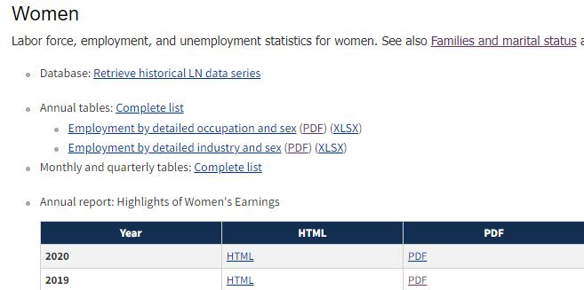
Methods

Slide 7
Methods
Removing the null and NaN (not a number) data in the Excel CSV file.
Worked with a sample size of 607.
Variables: COVID-19.
Downloaded the PDF from the U.S. Bureau of Labor Statistics websites, imported the information into Python, created histograms to show the data.
Used Tableau to display visualizations of the results for Caucasian, African American, Asian, and Hispanic/Latino women.

Slide 8
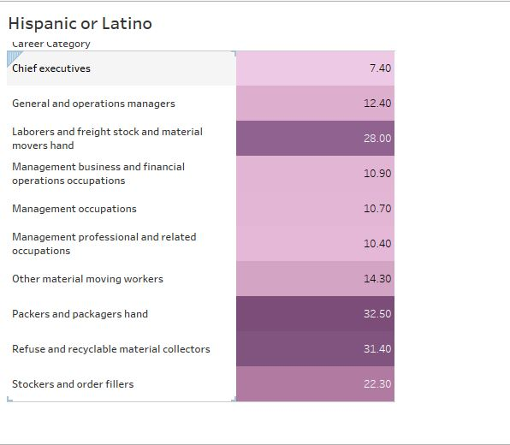
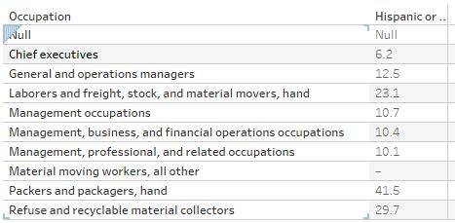
2020
2019
This statistical information shows that chief executives increased in the year of 2020 by 1.2%. Laborers, financial operation occupations, and management occupations had an increase as well. For laborers, there was a 4.9 percent increase. The main career in these specific categories shows that there was also a decrease for packers and packagers for Hispanic women. For packers and packagers, there was a 9% decrease.
Results

Slide 9
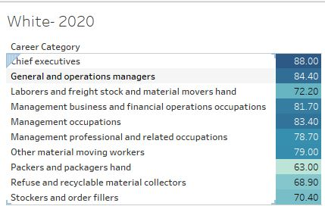
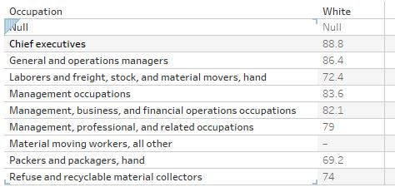
2019
For Caucasian women, the chief executive percentage went down by .8% in 2020. The percentage of Caucasian women that worked as general and operations managers movers went down by 2% in 2020. For laborers and material movers, it went down by 2%. There was also a decrease for packers and packers in 2020.
Results

Slide 10
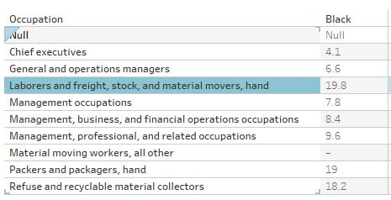
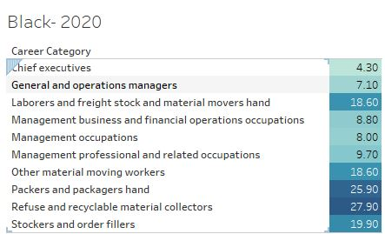
For African American women, the chief executive employment percentage went up by 2% in 2020 compared to year 2019. There was an increase for general and operations managers and management business and financial operations occupations. There was a decrease in 2020 for laborers and materials movers in the year 2020.
Results

Slide 11
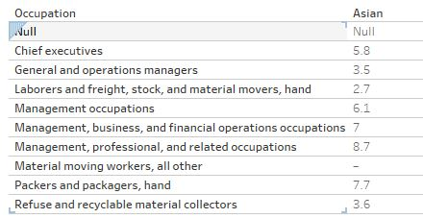
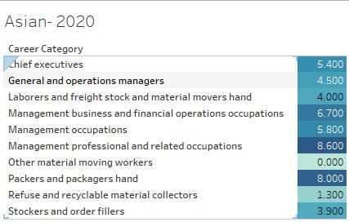
For Asian women, there was a .4% decrease in 2020 for the chief executive position. In 2020, the general and operations managers increased by 1%. There was an increase in laborers in 2020 for Asian women. There was an increase for packers and packers in 2020 as well as for management occupations.
Results

Slide 12
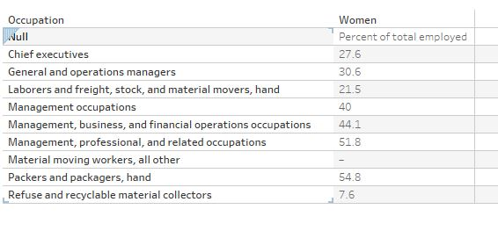
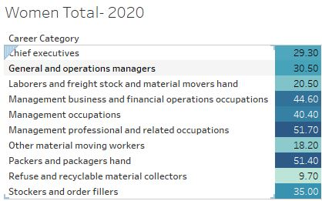
For women of all demographics, the total percentage increased in 2020 for chief executives by 1.7%. It decreased in 2020 for general and operations managers for women by .1%. There was a decrease for laborers in 2020 for women. It appears that there was an increase for management positions for women in the year 2020 for the total demographic of all races.
Results

Slide 13
Women Labor Force/Employment Information - Summary
Asian women had the least amount of women employment for management, executive, and labor positions in American in 2020.
Caucasian women had the highest percentages employed for executive, management, and financial operations occupations in 2019 and 2020.
The employment percentage of women for 2020 was 51.7% for all groups: African American, Caucasian, Asian, and Hispanic or Latino.

Slide 14
Conclusion
The percentage of women in management professional related occupations was greater than men in 2020, even with the effects of the pandemic.
Business management positions increased by .5% in 2020.
Chief executive, management, and business positions increased much greater than labor positions for women in 2020.
Women laboring job positions decreased in 2020 due to the pandemic.

